Slide 1
Lecture: Edge Detection
Juan Carlos Niebles and Ranjay Krishna
Stanford Vision and Learning Lab
Notes:
Edges are significant local changes in the image and are important features for analyzing images.Edges typically occur on the boundary between two different regions in an image.

Slide 2
Continuing from last lecture
Linear Systems
Convolution
Correlation

Slide 3
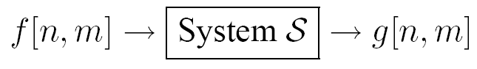
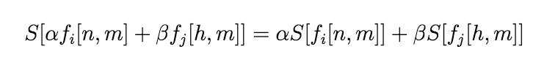
Linear Systems (filters)
Linear filtering:
Form a new image whose pixels are a weighted sum of original pixel values
Use the same set of weights at each point
S is a linear system (function) iff it S satisfies
superposition property
Notes:
Moving average is an example of a linear filter.
Here a more general definition.

Slide 4
2D impulse function
1 at [0,0].
0 everywhere else

Slide 5
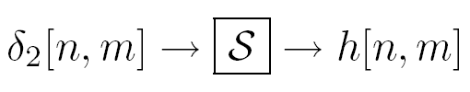
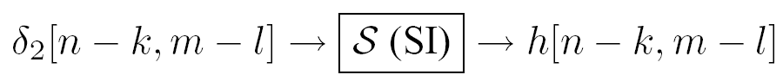
LSI (linear shift invariant) systems
Impulse response
Notes:
LSI systems can be characterized by the impulse response.
\delta_2 is the impulse (an image with 1 pixel =1, all the rest =0)
h is the response

Slide 6
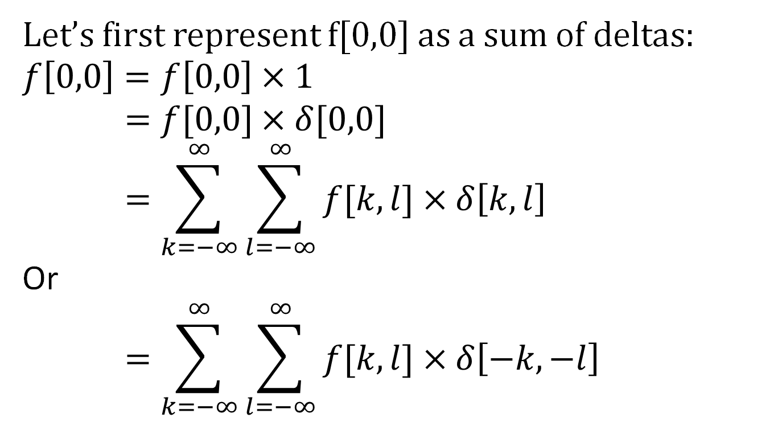
Why are convolutions flipped?
Let’s first represent f[0,0] as a sum of deltas:
$$f\left[0,0\right]=f\left[0,0\right]×1$$
$$=f[0,0]×δ[0,0]$$
$$=\sum_{k=−∞}^{∞}{\sum_{l=−∞}^{∞}{f[k,l]×δ\left[k,l\right]}}$$
Or
$$=\sum_{k=−∞}^{∞}{\sum_{l=−∞}^{∞}{f[k,l]×δ\left[−k,−l\right]}}$$

Slide 7
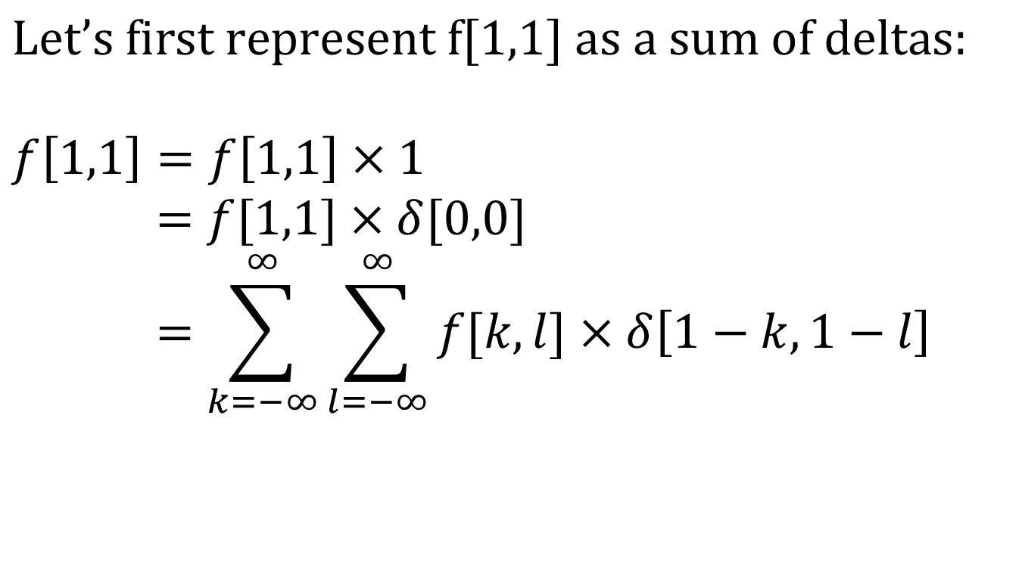
Why are convolutions flipped?
$$\text{Let}\text{’}\text{s} \text{first} \text{represent} \text{f}\text{[1,1] }\text{as} \text{a} \text{sum} \text{of} \text{deltas}\text{:}$$
$$f\left[1,1\right]=f\left[1,1\right]×1$$
$$=f[1,1]×δ[0,0]$$
$$=\sum_{k=−∞}^{∞}{\sum_{l=−∞}^{∞}{f[k,l]×δ\left[1−k,1−l\right]}}$$

Slide 8
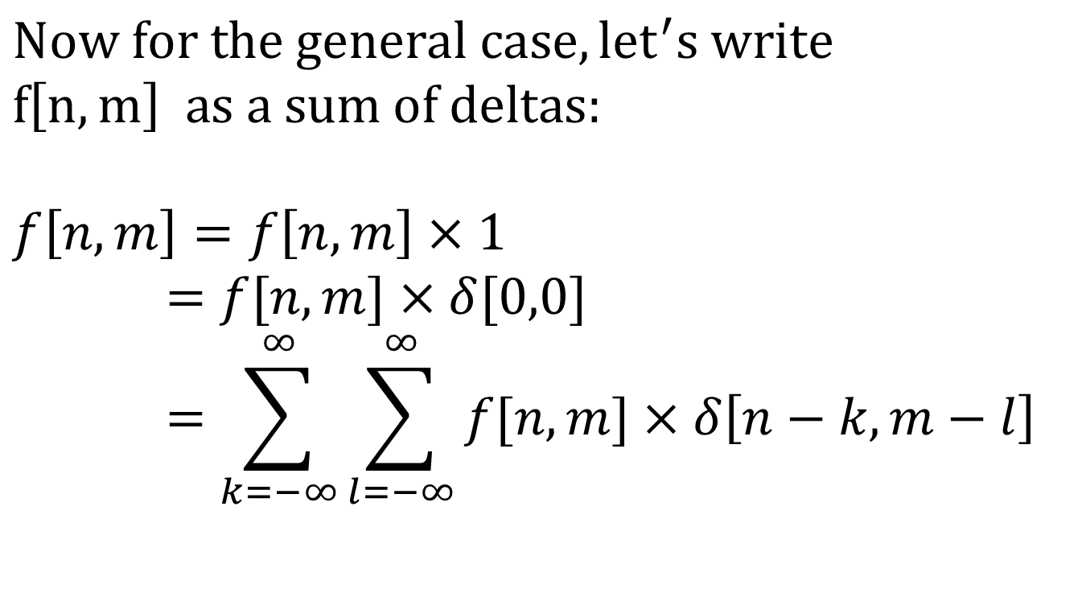
Why are convolutions flipped?
$$Now for the general case, {let}^{′}s write$$
$$f\left[n,m\right] as a sum of deltas:$$
$$f\left[n,m\right]=f\left[n,m\right]×1$$
$$=f[n,m]×δ[0,0]$$
$$=\sum_{k=−∞}^{∞}{\sum_{l=−∞}^{∞}{f[n,m]×δ\left[n−k,m−l\right]}}$$

Slide 9
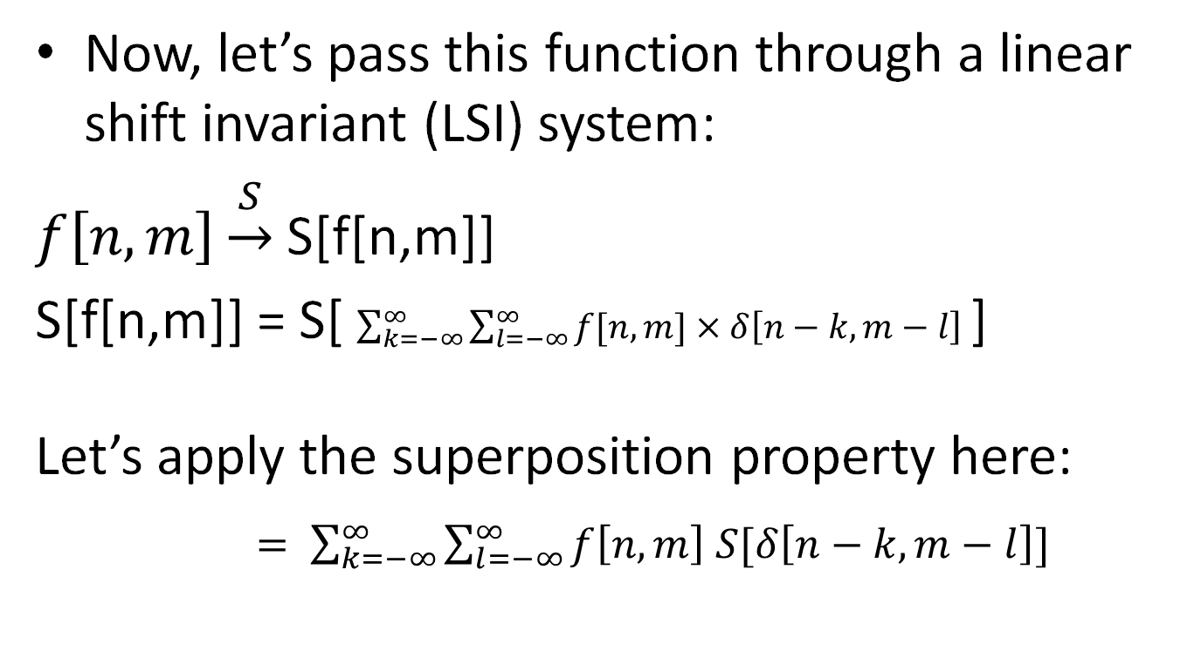
Why are convolutions flipped?
Now, let’s pass this function through a linear shift invariant (LSI) system:
$f\left[n,m\right]\underset{→}{S}$S[f[n,m]]
S[f[n,m]] = S[ $\sum_{k=−∞}^{∞}{\sum_{l=−∞}^{∞}{f[n,m]×δ\left[n−k,m−l\right]}}$]
Let’s apply the superposition property here:
$= \sum_{k=−∞}^{∞}{\sum_{l=−∞}^{∞}{f\left[n,m\right] S[δ\left[n−k,m−l\right]}}]$

Slide 10
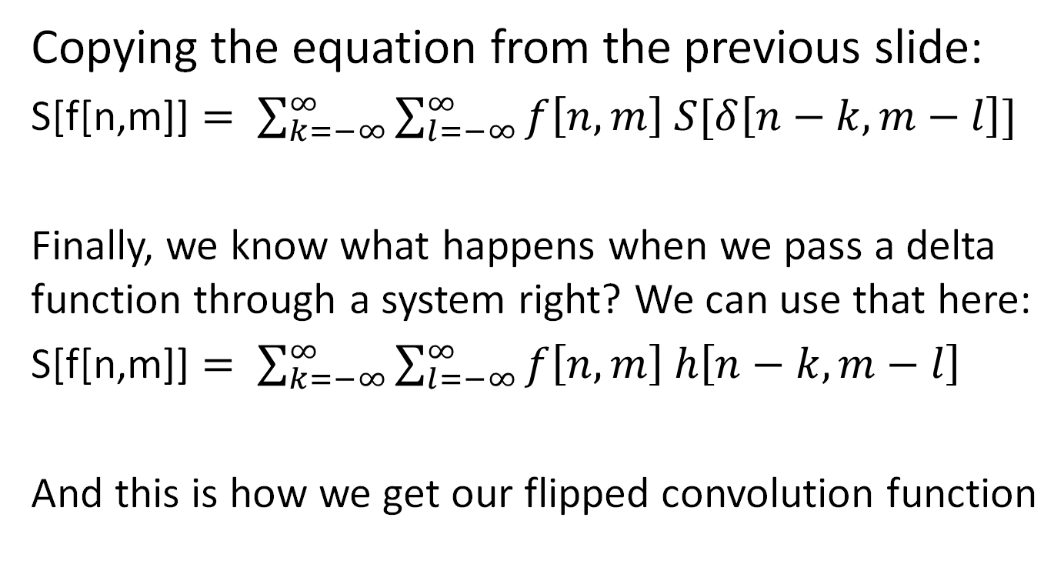
Why are convolutions flipped?
Copying the equation from the previous slide:
S[f[n,m]] $= \sum_{k=−∞}^{∞}{\sum_{l=−∞}^{∞}{f\left[n,m\right] S[δ\left[n−k,m−l\right]}}]$
Finally, we know what happens when we pass a delta function through a system right? We can use that here:
S[f[n,m]] $= \sum_{k=−∞}^{∞}{\sum_{l=−∞}^{∞}{f\left[n,m\right] h\left[n−k,m−l\right]}}$
And this is how we get our flipped convolution function

Slide 11
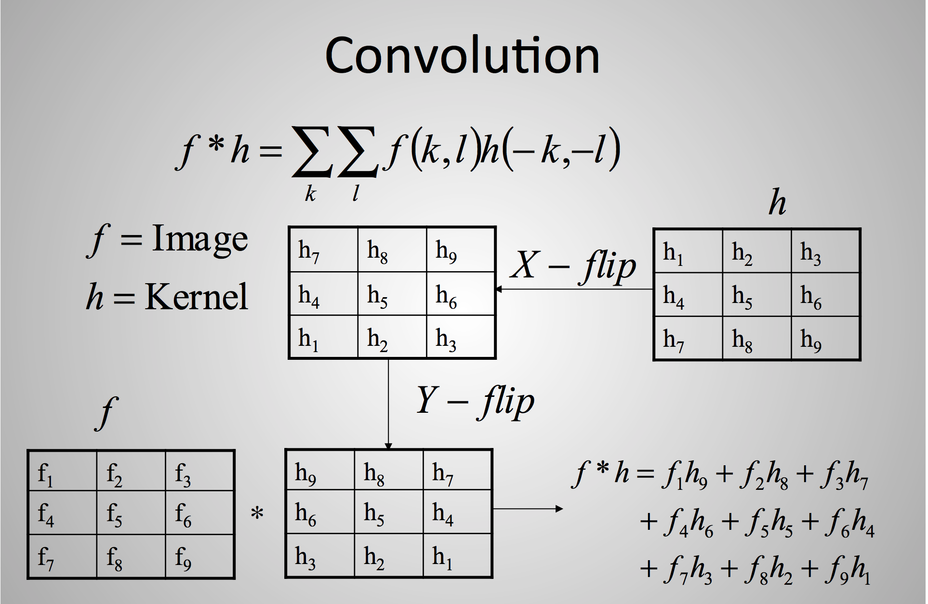
Slide credit: Ulas Bagci

Slide 12
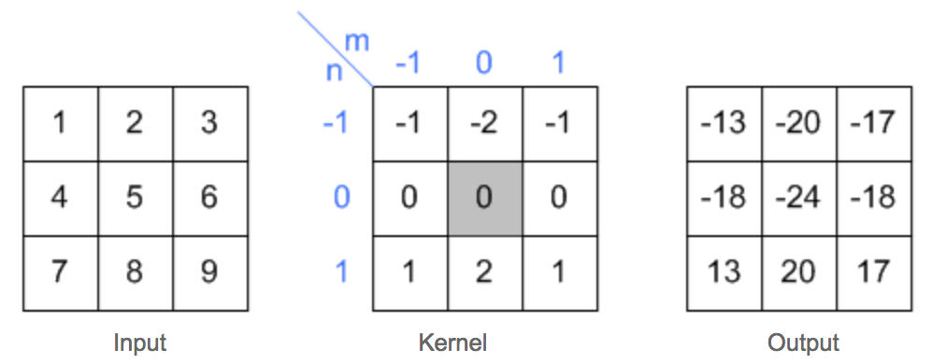
2D convolution example
Slide credit: Song Ho Ahn

Slide 13
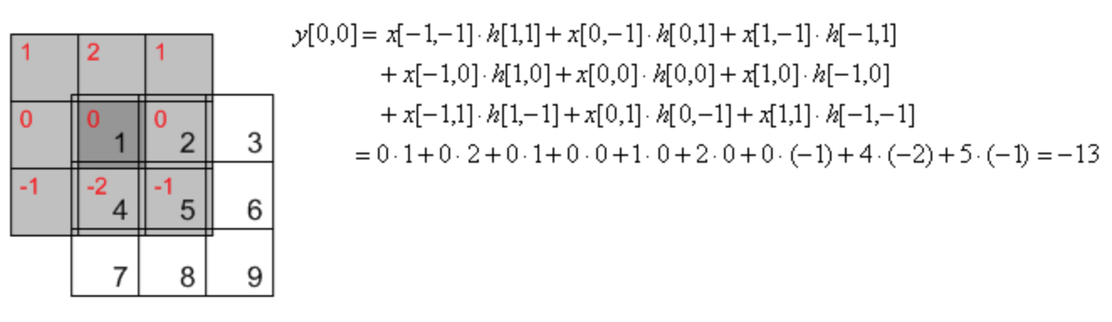
2D convolution example
Slide credit: Song Ho Ahn

Slide 14
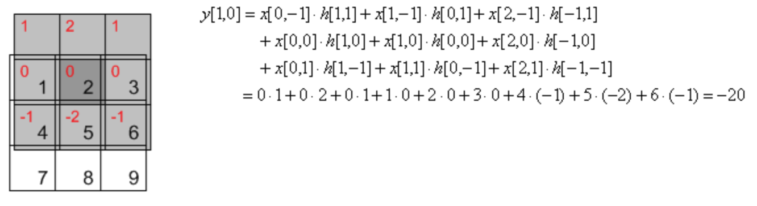
2D convolution example
Slide credit: Song Ho Ahn

Slide 15
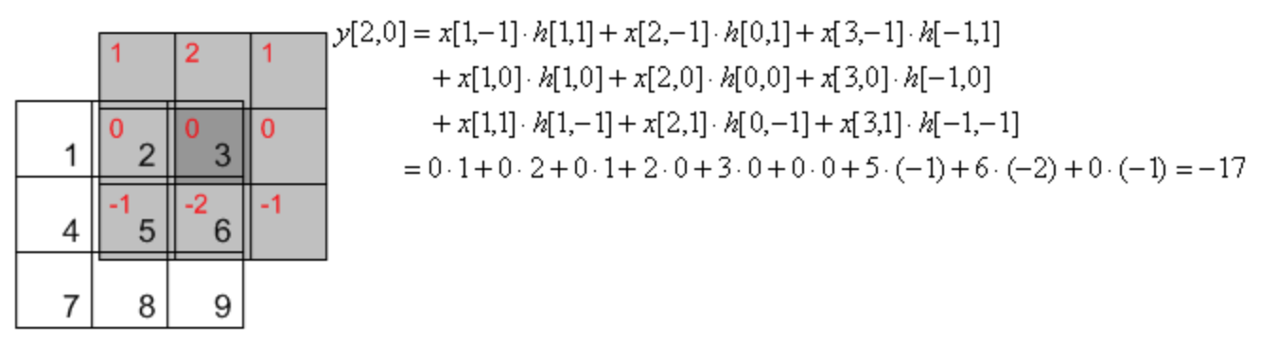
2D convolution example
Slide credit: Song Ho Ahn

Slide 16
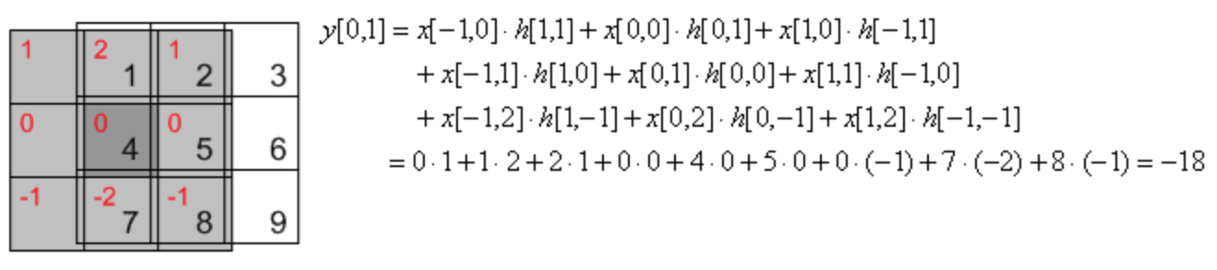
2D convolution example
Slide credit: Song Ho Ahn

Slide 17
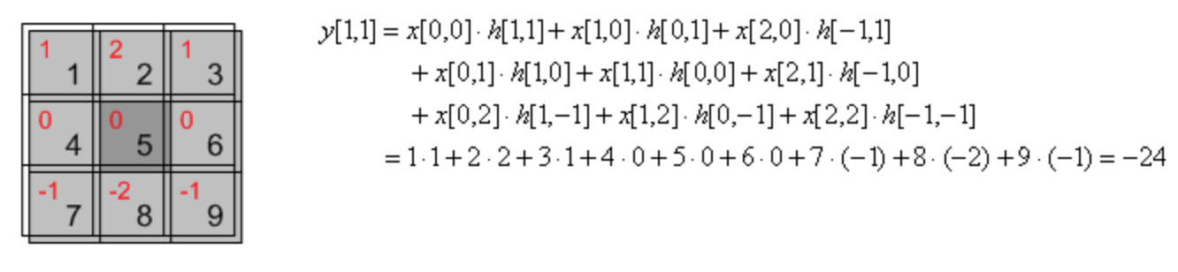
2D convolution example
Slide credit: Song Ho Ahn

Slide 18
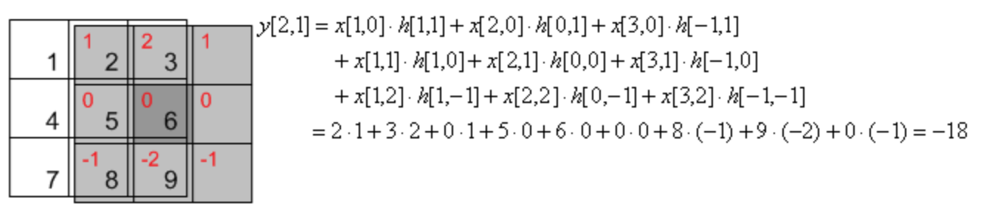
2D convolution example
Slide credit: Song Ho Ahn

Slide 19
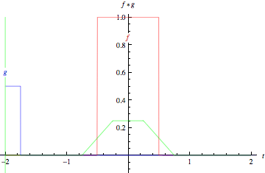
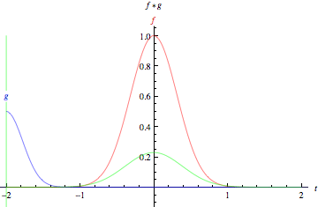
Slide credit: Wolfram Alpha

Slide 20
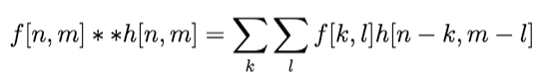
(Cross) correlation (symbol: )
Cross correlation of two 2D signals f[n,m] and g[n,m]
Notes:
Equation is about the same.
Difference is with the complex conjugate)

Slide 21
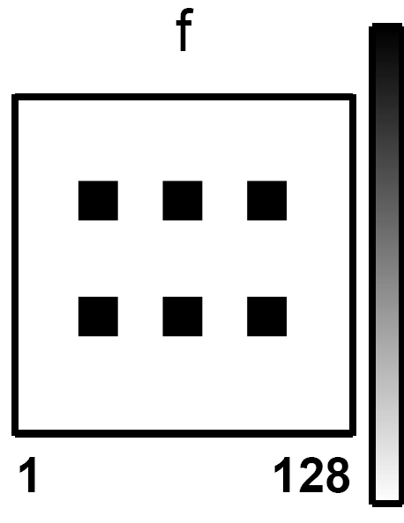
(Cross) correlation – example
Courtesy of J. Fessler
Notes:
Use: compare similarity between “kernel” and image.

Slide 22
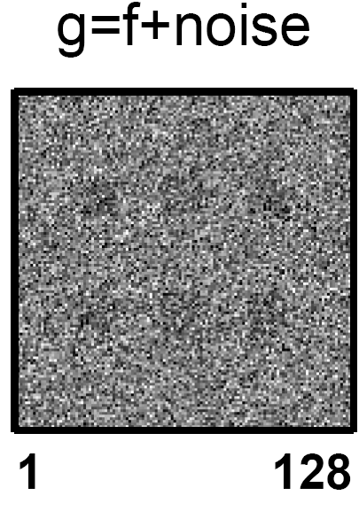
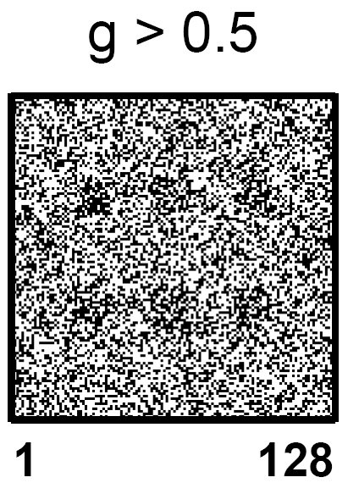
(Cross) correlation – example
Courtesy of J. Fessler
Notes:
Use: compare similarity between “kernel” and image.

Slide 23
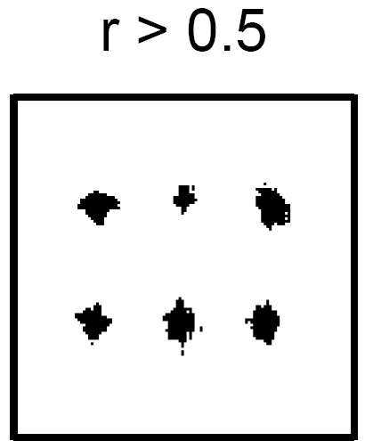
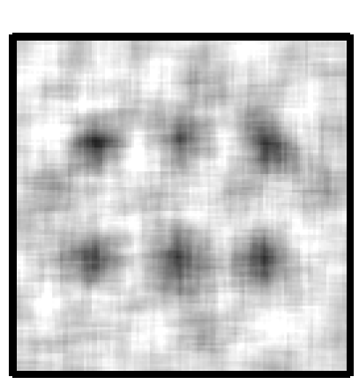
(Cross) correlation – example
Courtesy of J. Fessler
numpy’s correlate
Notes:
Use: compare similarity between “kernel” and image.

Slide 24
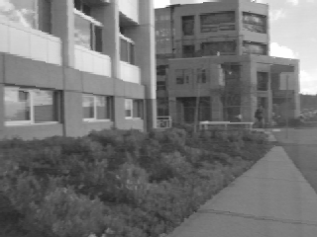
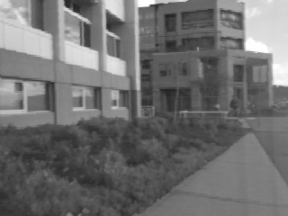
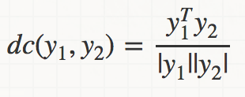
(Cross) correlation – example
Left
Right
scanline
Norm. cross corr. score

Slide 25
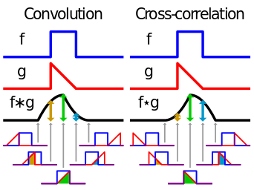
Convolution vs. (Cross) Correlation
f*h
f**h

Slide 26
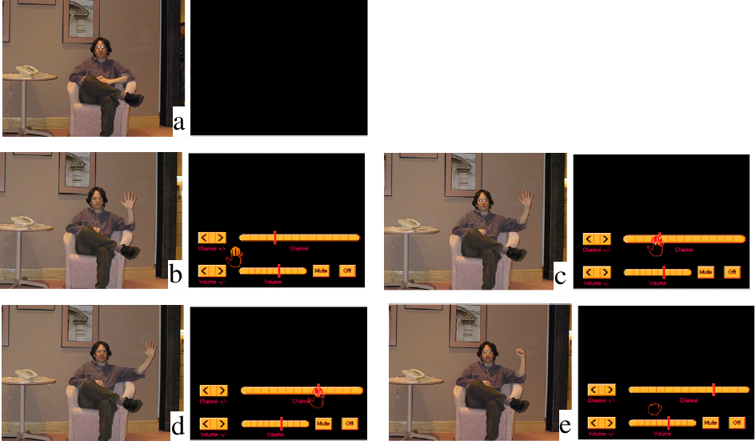
Cross Correlation Application: Vision system for TV remote control
- uses template matching
Figure from “Computer Vision for Interactive Computer Graphics,” W.Freeman et al, IEEE Computer Graphics and Applications, 1998 copyright 1998, IEEE
Notes:
This is a figure from the book, figure 7.16. Read the caption for the story!

Slide 27
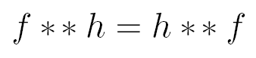
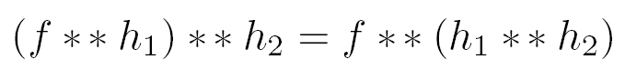
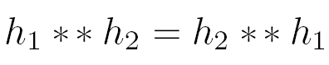
properties
• Commutative property:
• Associative property:
• Distributive property:
The order doesn’t matter!

Slide 28
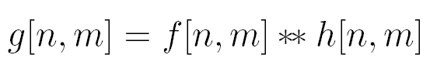
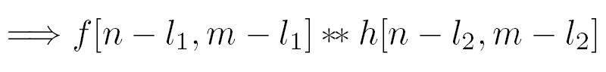
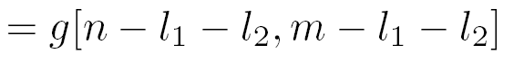
properties
• Shift property:
• Shift-invariance:

Slide 29
Convolution vs. (Cross) Correlation
A convolution is an integral that expresses the amount of overlap of one function as it is shifted over another function.
convolution is a filtering operation
Correlation compares the similarity of two sets of data. Correlation computes a measure of similarity of two input signals as they are shifted by one another. The correlation result reaches a maximum at the time when the two signals match best .
correlation is a measure of relatedness of two signals

Slide 30
What we will learn today
Edge detection
Image Gradients
A simple edge detector
Sobel edge detector
Canny edge detector
Hough Transform
Some background reading:
Forsyth and Ponce, Computer Vision, Chapter 8

Slide 31
What we will learn today
Edge detection
Image Gradients
A simple edge detector
Sobel edge detector
Canny edge detector
Hough Transform
Some background reading:
Forsyth and Ponce, Computer Vision, Chapter 8

Slide 32


Slide 33
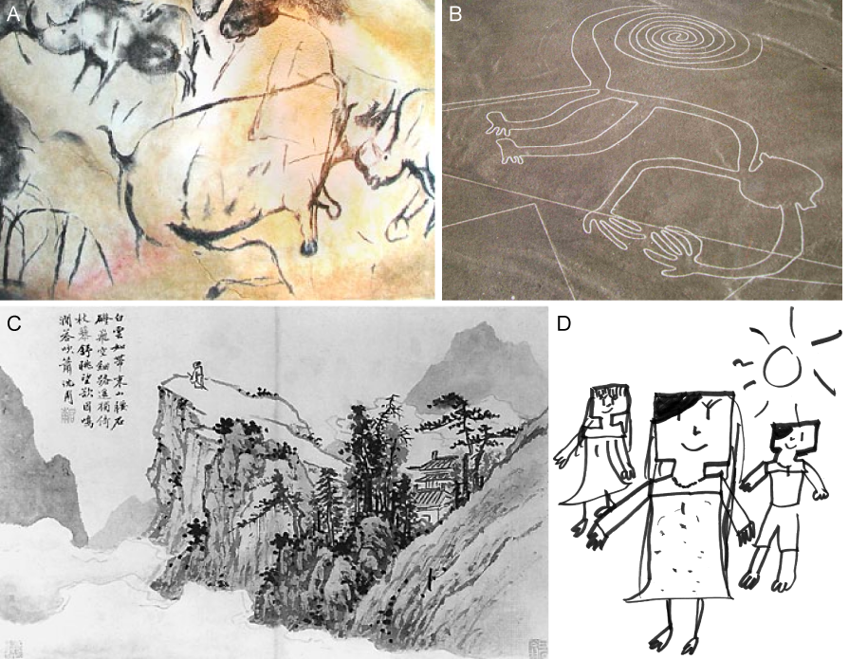
Cave painting at Chauvet, France, about 30,000 B.C.;
Aerial photograph of the picture of a monkey as part of the Nazca Lines geoglyphs, Peru, about 700 – 200 B.C.;
Shen Zhou (1427-1509 A.D.): Poet on a mountain top, ink on paper, China;
Line drawing by 7-year old I. Lleras (2010 A.D.).
Notes:
Edges are significant local changes in the image and are important features for analyzing images. Edges typically occur on the boundary between two different regions in an image.

Slide 34
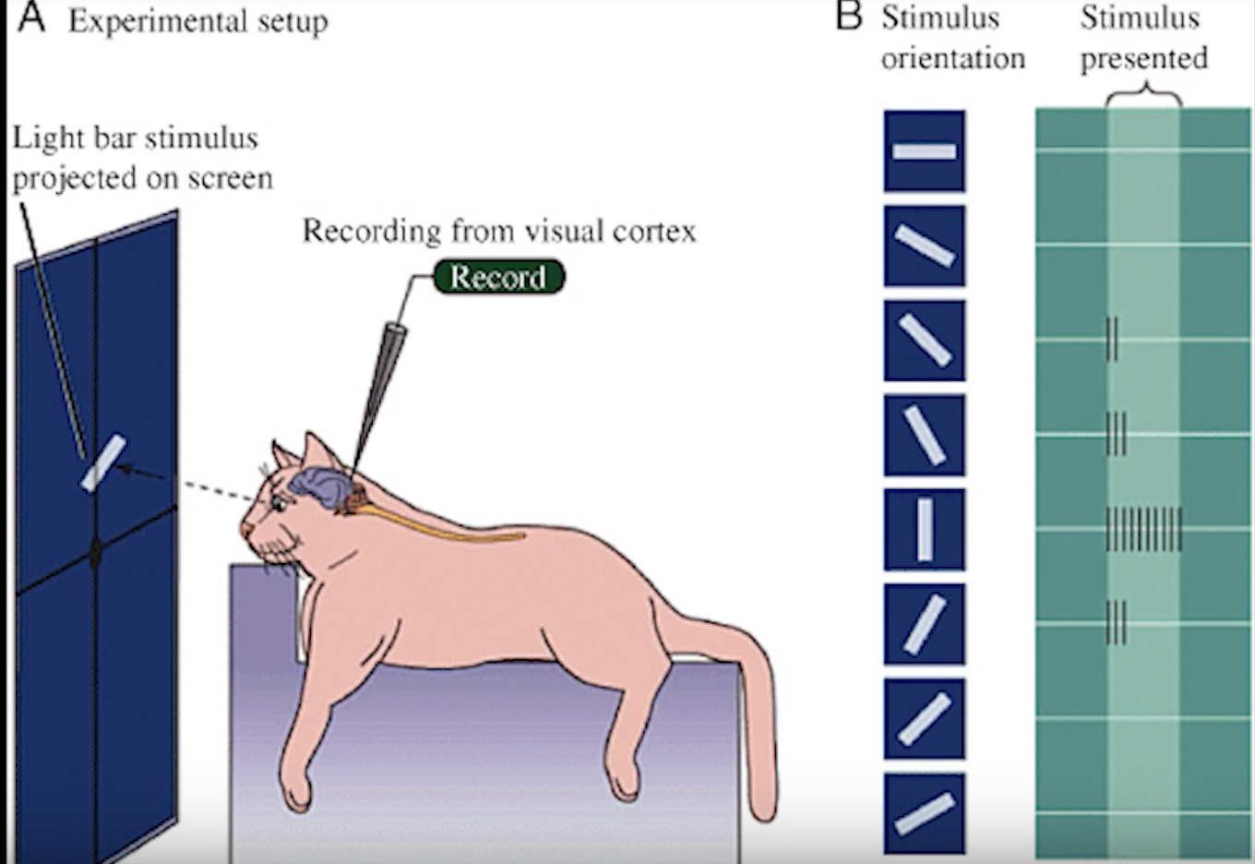
Hubel & Wiesel, 1960s

Slide 35
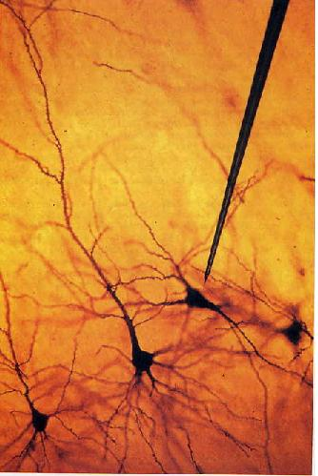
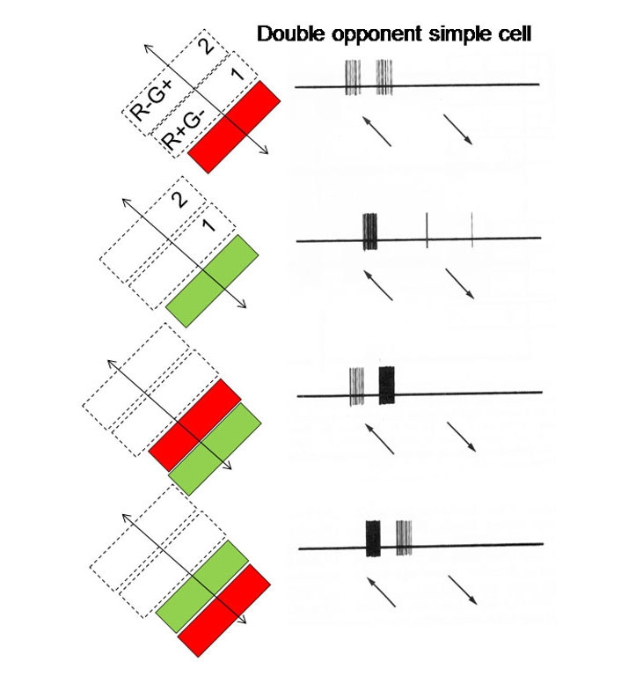
We know edges are special from human (mammalian) vision studies
Hubel & Wiesel, 1960s
Notes:
Hubel and Wiesel started out by trying to get neurons in the visual cortex to respond to traditional visual stimuli such as dots. They had little success. No matter the size or position of the circles, their neurons just couldn’t care less. Then one day while they were recording from yet another stubbornly silent neuron, it suddenly started firing like crazy as they changed the projection slide that they were using to present the stimuli. Turns out, the cell was responding to the edge of the slide. That’s when Hubel and Wiesel discovered that there are cells specialized for detecting lines—a basic feature of the visual world.

Slide 36
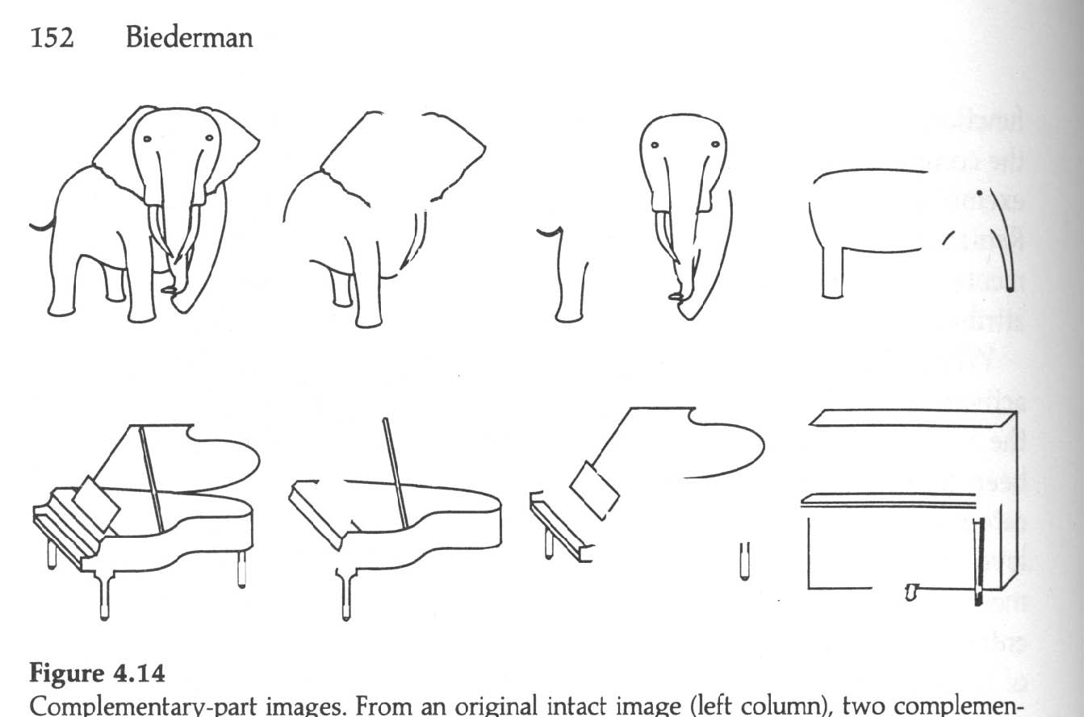
We know edges are special from human (mammalian) vision studies
Notes:
Part-deleted complementary images were created by deleting approximately half the components from each image. In this way each complementary images contained about 50% of the original contour. Put together the two complementary images would reproduce the intact line drawing. A same name, different exemplar image was also created (right column) to assess non-visual priming in a naming experiment (Biederman and Cooper, 1991).
Performance of human subjects on identical and complement images was strikingly different indicating that complementary part-deleted image pairs were not equivalent to each other for human observers. In fact, the complement image was perceived as if it were a different exemplar of the same category.

Slide 37
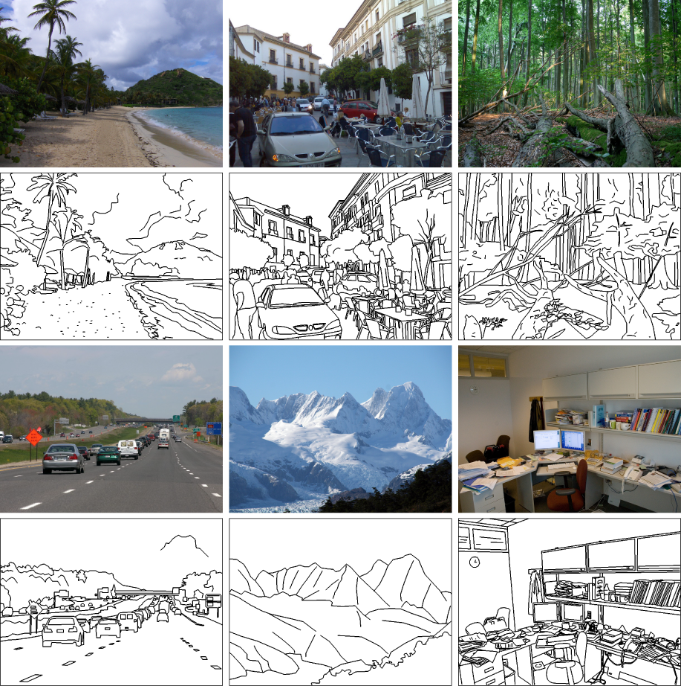
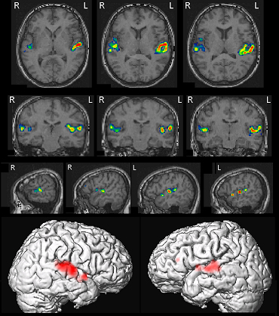
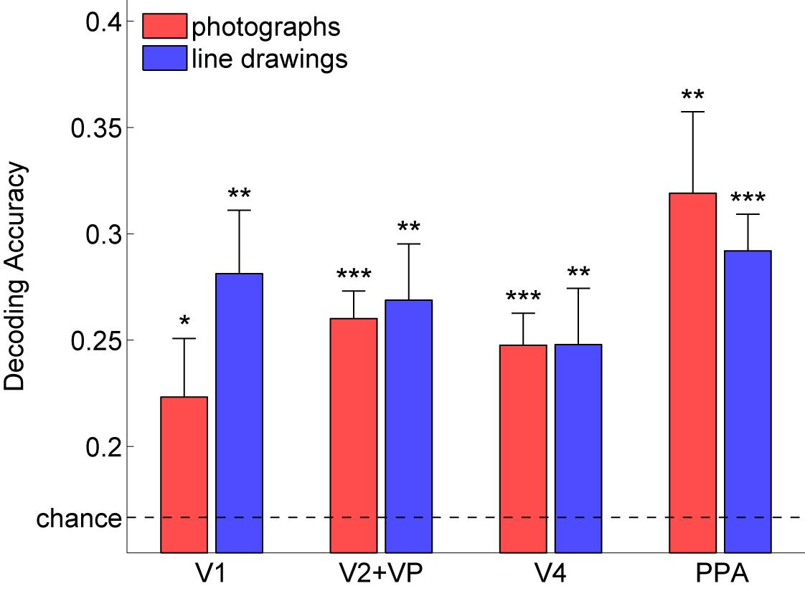
Walther, Chai, Caddigan, Beck & Fei-Fei, PNAS, 2011
Notes:
They collected fMRI data while participants viewed photographs and line drawings of beaches, city streets, forests, highways, mountains, and offices. Despite the marked difference in scene statistics, we were able to decode scene category from fMRI data for line drawings just as well as from activity for color photographs,
global scene structure, which is preserved in line drawings, plays an integral part in representing scene categories

Slide 38
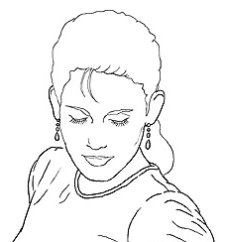
Edge detection
Goal: Identify sudden changes (discontinuities) in an image
Intuitively, most semantic and shape information from the image can be encoded in the edges
More compact than pixels
Ideal: artist’s line drawing (but artist is also using object-level knowledge)
Source: D. Lowe

Slide 39
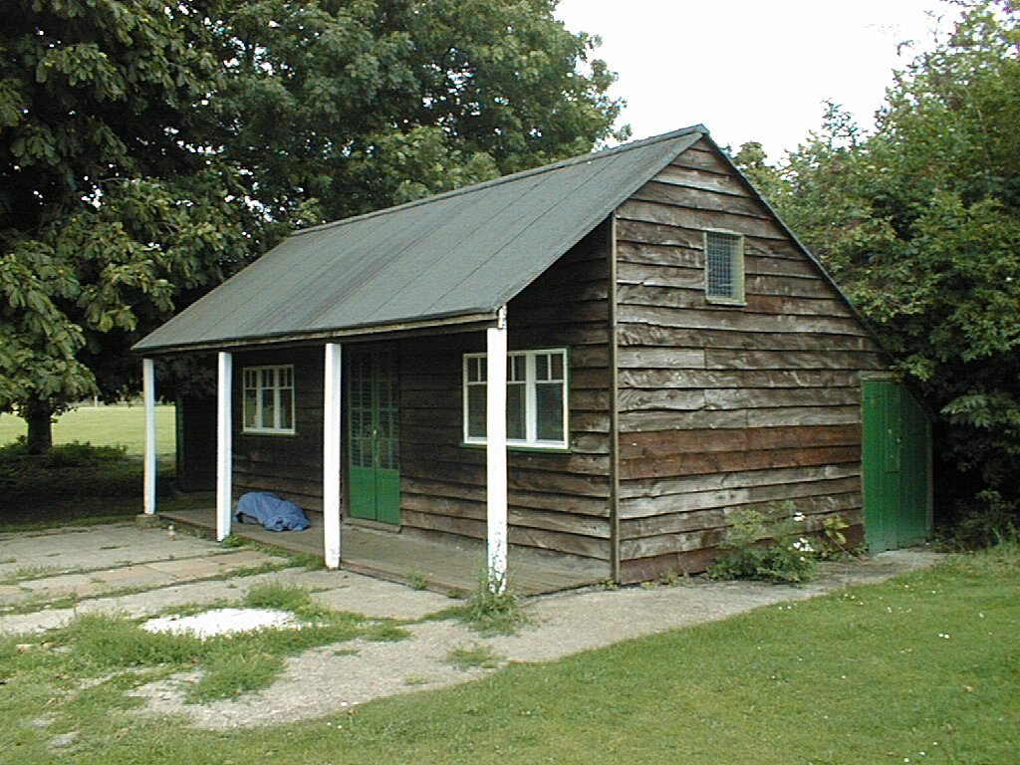
Why do we care about edges?
Extract information, recognize objects
Recover geometry and viewpoint
Vertical vanishing
point
(at infinity)
Vanishing
line
Vanishing
point
Vanishing
point
Source: J. Hayes

Slide 40
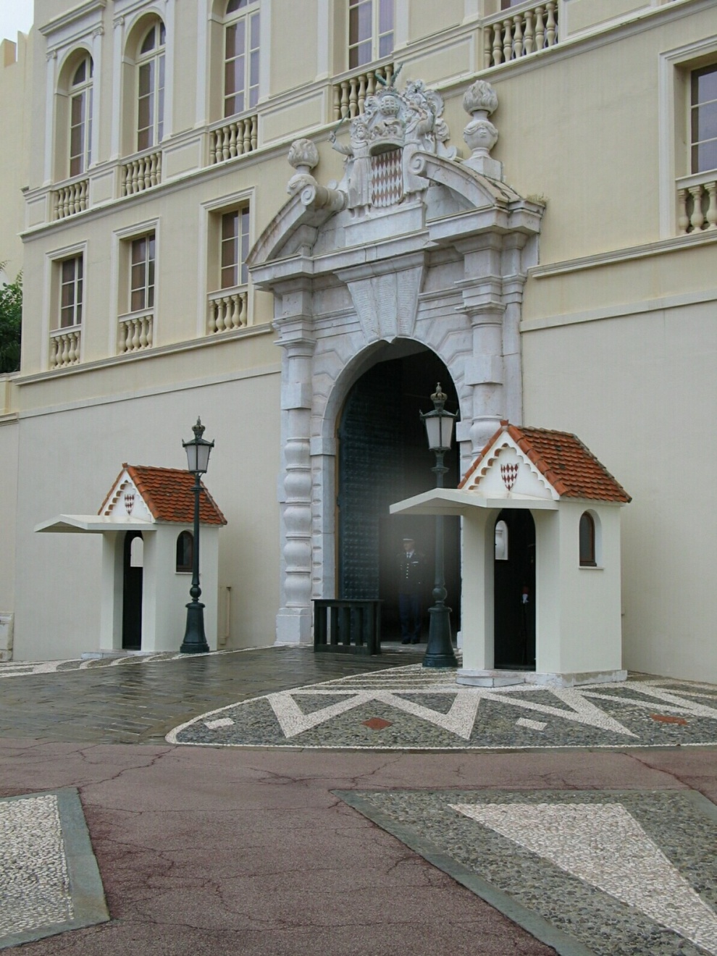
Origins of edges
surface normal discontinuity
depth discontinuity
surface color discontinuity
illumination discontinuity
Source: D. Hoiem

Slide 41
Closeup of edges
Surface normal discontinuity
Source: D. Hoiem

Slide 42
Closeup of edges
Depth discontinuity
Source: D. Hoiem

Slide 43
Closeup of edges
Surface color discontinuity
Source: D. Hoiem

Slide 44
What we will learn today
Edge detection
Image Gradients
A simple edge detector
Sobel edge detector
Canny edge detector
Hough Transform

Slide 45
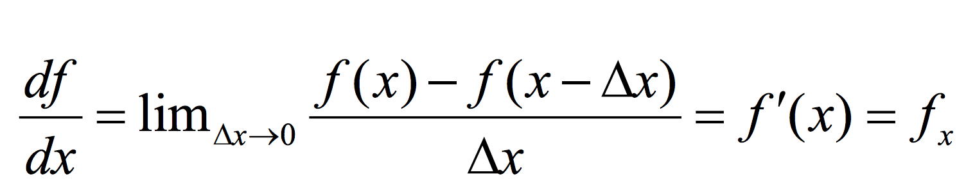
Derivatives in 1D

Slide 46
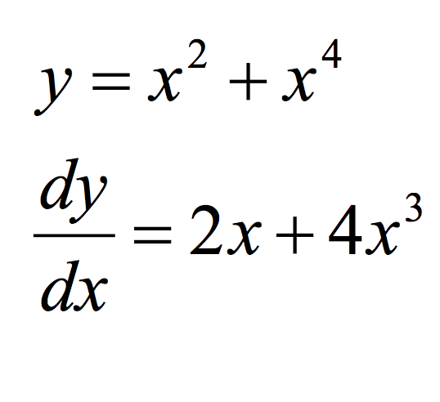
Derivatives in 1D - example

Slide 47
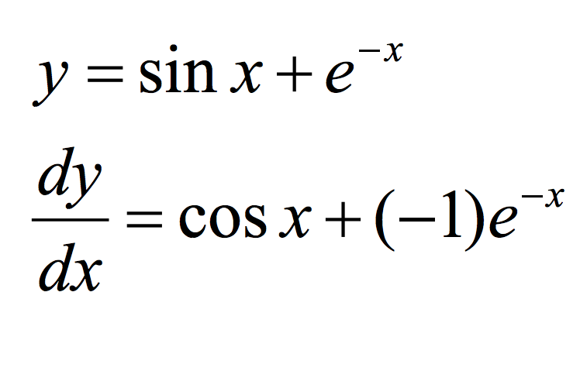
Derivatives in 1D - example
Slide credit: Dr Mubarak

Slide 48



Discrete Derivative in 1D

Slide 49

Types of Discrete derivative in 1D
Backward
Forward
Central

Slide 50
1D discrete derivate filters
Backward filter: [0 1 -1]
Forward: [-1 1 0]
Central: [ 1 0 -1]

Slide 51
1D discrete derivate filters
Backward filter: [0 1 -1]

Slide 52
1D discrete derivate filters
Backward filter: [0 1 -1]
Forward: [-1 1 0]

Slide 53

1D discrete derivate example

Slide 54

Discrete derivate in 2D

Slide 55
Discrete derivate in 2D

Slide 56

Discrete derivate in 2D

Slide 57

2D discrete derivative filters
What does this filter do?

Slide 58

2D discrete derivative filters
What about this filter?

Slide 59

2D discrete derivative - example

Slide 60
2D discrete derivative - example
What happens when we apply this filter?

Slide 61

2D discrete derivative - example
What happens when we apply this filter?

Slide 62
2D discrete derivative - example
Now let’s try the other filter!

Slide 63

2D discrete derivative - example
What happens when we apply this filter?

Slide 64

3x3 image gradient filters

Slide 65
What we will learn today
Edge detection
Image Gradients
A simple edge detector
Sobel edge detector
Canny edge detector
Hough Transform

Slide 66

Characterizing edges
An edge is a place of rapid change in the image intensity function
intensity function (along horizontal scanline)
image
first derivative
edges correspond to extrema of derivative

Slide 67





Image gradient
The gradient of an image:
The gradient vector points in the direction of most rapid increase in intensity
The gradient direction is given by
how does this relate to the direction of the edge?
The edge strength is given by the gradient magnitude
Source: Steve Seitz
Notes:
give definition of partial derivative: lim h->0 [f(x+h,y) – f(x,y)]/h

Slide 68
Finite differences: example
Original
Image
Gradient magnitude
x-direction
y-direction
Which one is the gradient in the x-direction? How about y-direction?

Slide 69



Intensity profile
Intensity
Gradient
Source: D. Hoiem

Slide 70




Effects of noise
Consider a single row or column of the image
Plotting intensity as a function of position gives a signal
Where is the edge?
Source: S. Seitz
Notes:
How to fix?

Slide 71


Effects of noise
Notes:
How to fix?

Slide 72
Effects of noise
Finite difference filters respond strongly to noise
Image noise results in pixels that look very different from their neighbors
Generally, the larger the noise the stronger the response
What is to be done?
Smoothing the image should help, by forcing pixels different to their neighbors (=noise pixels?) to look more like neighbors
Source: D. Forsyth

Slide 73
Effects of noise
Finite difference filters respond strongly to noise
Image noise results in pixels that look very different from their neighbors
Generally, the larger the noise the stronger the response
What is to be done?
Smoothing the image should help, by forcing pixels different to their neighbors (=noise pixels?) to look more like neighbors
Source: D. Forsyth

Slide 74




Smoothing with different filters
Mean smoothing
Gaussian (smoothing * derivative)
Slide credit: Steve Seitz

Slide 75

Smoothing with different filters
Slide credit: Steve Seitz

Slide 76




Solution: smooth first
f
g
f * g
To find edges, look for peaks in
Source: S. Seitz

Slide 77

Derivative theorem of convolution
This theorem gives us a very useful property:
This saves us one operation:
f
Source: S. Seitz

Slide 78


Derivative of Gaussian filter
* [1 0 -1] =
2D-gaussian
x - derivative

Slide 79


Derivative of Gaussian filter
x-direction
y-direction

Slide 80
Derivative of Gaussian filter

Slide 81



Tradeoff between smoothing at different scales
1 pixel
3 pixels
7 pixels
Smoothed derivative removes noise, but blurs edge. Also finds edges at different “scales”.
Source: D. Forsyth

Slide 82

Designing an edge detector
Criteria for an “optimal” edge detector:
Good detection: the optimal detector must minimize the probability of false positives (detecting spurious edges caused by noise), as well as that of false negatives (missing real edges)

Slide 83
Designing an edge detector
Criteria for an “optimal” edge detector:
Good detection: the optimal detector must minimize the probability of false positives (detecting spurious edges caused by noise), as well as that of false negatives (missing real edges)
Good localization: the edges detected must be as close as possible to the true edges

Slide 84
Designing an edge detector
Criteria for an “optimal” edge detector:
Good detection: the optimal detector must minimize the probability of false positives (detecting spurious edges caused by noise), as well as that of false negatives (missing real edges)
Good localization: the edges detected must be as close as possible to the true edges
Single response: the detector must return one point only for each true edge point; that is, minimize the number of local maxima around the true edge

Slide 85
What we will learn today
Edge detection
Image Gradients
A simple edge detector
Sobel Edge detector
Canny edge detector
Hough transform

Slide 86


Sobel Operator
uses two 3×3 kernels which are convolved with the original image to calculate approximations of the derivatives
one for horizontal changes, and one for vertical

Slide 87

Sobel Operation
Smoothing + differentiation
Gaussian smoothing
differentiation

Slide 88


Sobel Operation
Magnitude:
Angle or direction of the gradient:
Notes:
Gradient is a vector!

Slide 89
Sobel Filter example
Notes:
We can threshold the gradient map, and choose edges to be the pixels above T.

Slide 90

Sobel Filter Problems
Poor Localization (Trigger response in multiple adjacent pixels)
Thresholding value favors certain directions over others
Can miss oblique edges more than horizontal or vertical edges
False negatives
Notes:
Thresholding is….

Slide 91
What we will learn today
Edge detection
Image Gradients
A simple edge detector
Sobel Edge detector
Canny edge detector
Hough Transform

Slide 92
Canny edge detector
This is probably the most widely used edge detector in computer vision
Theoretical model: step-edges corrupted by additive Gaussian noise
Canny has shown that the first derivative of the Gaussian closely approximates the operator that optimizes the product of signal-to-noise ratio and localization
J. Canny, A Computational Approach To Edge Detection, IEEE Trans. Pattern Analysis and Machine Intelligence, 8:679-714, 1986.

Slide 93
Canny edge detector
Suppress Noise
Compute gradient magnitude and direction
Apply Non-Maximum Suppression
Assures minimal response
Use hysteresis and connectivity analysis to detect edges

Slide 94

Example
original image

Slide 95


Derivative of Gaussian filter
x-direction
y-direction

Slide 96



Compute gradients (DoG)
X-Derivative of Gaussian
Y-Derivative of Gaussian
Gradient Magnitude
Source: J. Hayes

Slide 97

Get orientation at each pixel
Source: J. Hayes
Notes:
Gives angle perpendicular to the edge.

Slide 98



Compute gradients (DoG)
X-Derivative of Gaussian
Y-Derivative of Gaussian
Gradient Magnitude

Slide 99
Canny edge detector
Suppress Noise
Compute gradient magnitude and direction
Apply Non-Maximum Suppression
Assures minimal response

Slide 100
Non-maximum suppression
Edge occurs where gradient reaches a maxima
Suppress non-maxima gradient even if it passes threshold
Only eight angle directions possible
Suppress all pixels in each direction which are not maxima
Do this in each marked pixel neighborhood

Slide 101





Remove spurious gradients
is the gradient at pixel (x, y)
$$\left|∇G\right|\left(x,y\right)$$
$$\left|∇G\right|\left(x,y\right)$$
$$\left|∇G\right|\left(x,y\right)> \left|∇G\right|\left(x′,y′\right)$$
$$\left|∇G\right|\left(x,y\right)> \left|∇G\right|\left(x′′,y′′\right)$$

Slide 102
Non-maximum suppression
Edge occurs where gradient reaches a maxima
Suppress non-maxima gradient even if it passes threshold
Only eight angle directions possible
Suppress all pixels in each direction which are not maxima
Do this in each marked pixel neighborhood

Slide 103


Non-maximum suppression
At q, we have a maximum if the value is larger than those at both p and at r. Interpolate to get these values.
Source: D. Forsyth
Notes:
A more advanced version looks beyond 8 directions…

Slide 104

Non-max Suppression
Before After

Slide 105
Canny edge detector
Suppress Noise
Compute gradient magnitude and direction
Apply Non-Maximum Suppression
Assures minimal response
Use hysteresis and connectivity analysis to detect edges

Slide 106



Slide 107
Hysteresis thresholding
Avoid streaking near threshold value
Define two thresholds: Low and High
If less than Low, not an edge
If greater than High, strong edge
If between Low and High, weak edge

Slide 108
Hysteresis thresholding
If the gradient at a pixel is
above High, declare it as an ‘strong edge pixel’
below Low, declare it as a “non-edge-pixel”
between Low and High
Consider its neighbors iteratively then declare it an “edge pixel” if it is connected to an ‘strong edge pixel’ directly or via pixels between Low and High

Slide 109
Hysteresis thresholding
strong edge pixel
weak but connected edge pixels
strong edge pixel
Source: S. Seitz
Notes:
Breadth first search in the homework.

Slide 110


Final Canny Edges

Slide 111
Canny edge detector
Filter image with x, y derivatives of Gaussian
Find magnitude and orientation of gradient
Non-maximum suppression:
Thin multi-pixel wide “ridges” down to single pixel width
Thresholding and linking (hysteresis):
Define two thresholds: low and high
Use the high threshold to start edge curves and the low threshold to continue them

Slide 112





Effect of σ (Gaussian kernel spread/size)
original
Canny with
Canny with
The choice of σ depends on desired behavior
large σ detects large scale edges
small σ detects fine features
Source: S. Seitz

Slide 113

Gradients
(e.g. Canny)
Color
Texture
Combined
Human

Slide 114

45 years of boundary detection
Source: Arbelaez, Maire, Fowlkes, and Malik. TPAMI 2011 (pdf)

Slide 115
What we will learn today
Edge detection
Image Gradients
A simple edge detector
Sobel Edge detector
Canny edge detector
Hough Transform

Slide 116
Intro to Hough transform
The Hough transform (HT) can be used to detect lines.
It was introduced in 1962 (Hough 1962) and first used to find lines in images a decade later (Duda 1972).
The goal is to find the location of lines in images.
Caveat: Hough transform can detect lines, circles and other structures ONLY if their parametric equation is known.
It can give robust detection under noise and partial occlusion

Slide 117



Prior to Hough transform
Assume that we have performed some edge detection, and a thresholding of the edge magnitude image.
Thus, we have some pixels that may partially describe the boundary of some objects.
Notes:
What is the simplest algorithm for this?
O(N^2) pairwise

Slide 118
Detecting lines using Hough transform
We wish to find sets of pixels that make up straight lines.
Consider a point of known coordinates (x_{i};y_{i})
There are many lines passing through the point (x_{i} ,y_{i} ).
Straight lines that pass that point have the form y_{i}= a*x_{i} + b
Common to them is that they satisfy the equation for some set of parameters (a, b)

Slide 119
Detecting lines using Hough transform
This equation can obviously be rewritten as follows:
b = -a*x_{i} + y_{i}
We can now consider x and y as parameters
a and b as variables.
This is a line in (a, b) space parameterized by x and y.
So: a single point in x₁,y₁-space gives a line in (a,b) space.
Another point (x₂, y₂ ) will give rise to another line (a,b) space.

Slide 120

Detecting lines using Hough transform
Notes:
What if we map all points from the red line into ab space?

Slide 121

Detecting lines using Hough transform

Slide 122
Detecting lines using Hough transform
Two points (x₁, y₁) and(x₂ y₂) define a line in the (x, y) plane.
These two points give rise to two different lines in (a,b) space.
In (a,b) space these lines will intersect in a point (a’ b’)
All points on the line defined by (x₁, y₁) and (x₂ , y₂) in (x, y) space will parameterize lines that intersect in (a’, b’) in (a,b) space.

Slide 123
Algorithm for Hough transform
Quantize the parameter space (a b) by dividing it into cells
This quantized space is often referred to as the accumulator cells.
Count the number of times a line intersects a given cell.
For each pair of points (x₁, y₁) and (x₂, y₂) detected as an edge, find the intersection (a’,b’) in (a, b)space.
Increase the value of a cell in the range [[a_{min}, a_{max}],[b_{min},b_{max}]] that (a’, b’) belongs to.
Cells receiving more than a certain number of counts (also called ‘votes’) are assumed to correspond to lines in (x,y) space.

Slide 124

Output of Hough transform
Here are the top 20 most voted lines in the image:

Slide 125
Other Hough transformations
We can represent lines as polar coordinates instead of y = a*x + b
Polar coordinate representation:
x*cosθ + y*sinθ = ρ
Can you figure out the relationship between
(x y) and (ρ θ)?

Slide 126

Other Hough transformations
Note that lines in (x y) space are not lines in (ρ θ) space, unlike (a b) space.
A vertical line will have θ=0 and ρ equal to the intercept with the x-axis.
A horizontal line will have θ=90 and ρ equal to the intercept with the y-axis.

Slide 127
Example video
https://youtu.be/4zHbI-fFIlI?t=3m35s

Slide 128
Concluding remarks
Advantages:
Conceptually simple.
Easy implementation
Handles missing and occluded data very gracefully.
Can be adapted to many types of forms, not just lines
Disadvantages:
Computationally complex for objects with many parameters.
Looks for only one single type of object
Can be “fooled” by “apparent lines”.
The length and the position of a line segment cannot be determined.
Co-linear line segments cannot be separated.

Slide 129
What we will learn today
Edge detection
Image Gradients
A simple edge detector
Sobel Edge detector
Canny edge detector
Hough Transform

